Slide 1




Research & Innovation Proposal
Proposal Name:
Quantum-Enhanced Financial Fraud Detection: A Quantum Graph Neural Network Approach
Initiative Category:
Cybersecurity
Sub Category:
Fraud Detection and Prevention
Round 1

Slide 2
Team Info Minimum size is 2 and maximum is 4
Name: Md. Zubair Title: CSE Student Institute: Green University of Bangladesh Phone 1: 01643196076 Phone 2: 01857155064 Email: mz548492@gmail.com | Name: Humayra Afia Hany Title: CSE Student Institute: Green University of Bangladesh Phone 1: Phone 2: Email:
Name: Sumaiya Akter Akhi Title: CSE student Institute: Green University of Bangladesh Phone 1: Phone 2: Email: | Name: Sharna Islam Farhana Title: CSE Student Institute: Green University of Bangladesh Phone 1: Phone 2: Email:
Please paste
your photo here
Please paste
your photo here
Please paste
your photo here
Please paste
your photo here
Round 1

Slide 3
Merit of the Initiative Assessment of the Proposal
Problem’s Root Cause Analysis | Addressability of the Problem | The proposed solution focuses on leveraging Quantum Graph Neural Network (QGNNs) within the realm of cybersecurity. Assessment: Our cybersecurity solution tackles the limitations of traditional fraud detection head-on. Through Quantum Computing techniques, it brings enhancement to accuracy, revolutionizing the fight against online financial fraud.
 | Evidence supporting the problem | Current data underscores the challenges in traditional fraud detection, revealing issues such adaptability to dynamic patterns , complex relationships and interconnected patterns, handling exponential data growth, limited holistic context understanding inability to capture non-linear structures etc. Assessment: Evident shortcomings in classical ML underscores the crucial need for improvement in fraud detection.
Economic Significance of the Problem |  | Fraud detection is economically crucial, spanning diverse sectors like banking, e-commerce, healthcare, FinTech, and insurance. Implementing advanced techniques becomes crucial to effectively counter the ever-changing tactics of fraudsters, thereby safeguarding economics activities and fostering trust in financial systems.
Round 1

Slide 4
Merit of the Initiative Assessment of the Proposal
Solution & Innovation Potential | Solution Design | The research approach of finding fraudulent in transaction was done by the following approach by using Cloud Based Quantum services as Bangladesh still don’t have any in-home Quantum Computer. Although having Quantum Computer will boost the efficiency. The procedure is - Graph construction: Form interconnected graphs with encoded features. Topological Data Analysis Quantum Encoding : Employ angle-encoding and linear transformation for quantum state representation. Variational Quantum Circuit Enhancement : To enhance node features. Unitary Gates and Classification Assessment: The solution, utilizing Quantum Graph Neural Networks and innovating quantum techniques, shows promise in revolutionizing fraud detection with enhanced accuracy and feature representation.
 | Innovation/Novelty | Our quantum-based approach creativity redefines frau detection, addressing limitations in traditional methods. Assessment: The solution showcases a groundbreaking shifts by introducing quantum properties , offering an innovating perspective to overcome classical limitations in fraud detection.
Round 1

Slide 5
Merit of the Initiative (Cont.) Assessment of the Proposal
Solution & Innovation Potential | Solution Feasibility & Practicality | Experiments on Qiskit confirm the efficiency of QGNN approach, achieving 94.5% accuracy with 6 qubits. Assessment: Outperforming classical approach by ~3% ,the solution demonstrates practicality and feasibility for enhanced fraud detection.
 | Impact, Value for Money | The AUC of 0.85 using 6 qubits , promises significant fraud detection improvement leading to excellent value for investment. Assessment: The solution’s impressive performances delivers substantial impact and offers optimal value for the investment.
Implementation | Team Composition & Strength | While the project draws inspiration from a group of quantum machine learning researchers, my team composition enriches diversity , incorporating my skills as a computer science undergrad. The fusion of their quantum expertise and my CS background enhances the project’s potential, ensuring a well-rounded approach to tackling fraud detection challenge.
Round 1

Slide 6
Merit of the Initiative (Cont.) Assessment of the Proposal
Implementation | Team Composition & Strength | Assessment: The collaborative team, blending quantum machine learning researchers and cs undergrad, provides a balanced mix of expertise . This diversity strengthens the project’s capabilities , fostering a comprehensive approach to innovative fraud detection solutions.
Implementation | Domain Specialist & Experience | The team comprises diverse expertise ,including Quantum Physics, Magnetism, Quantum Formalism, and Data Science. Although my consists cs undergrads, collaboration with these specialists enhances the project’s credibility. Assessment: The collaboration of different field specialists elevates credibility , enriching the project with diverse perspectives for enhanced success in innovating fraud detection.
Round 1

Slide 7
Merit of the Initiative (Cont.) Assessment of the Proposal
Implementation | Technology Selection | Quantum-inspired algorithms and Qiskit technology are chosen strategically, reflecting a forward looking approach to fraud detection. Assessment: The chosen technologies promise long-term benefits , ensuring the solution’s effectiveness in combating financial fraud.
 | Understanding the Ecosystem | The solution deeply understands the dynamic challenges of financial fraud , considering evolving tactics and diverse sectors for a comprehensive fraud detection approach. Assessment: The project’s grasp of the fraud ecosystem is concise , adaptive , and comprehensive.
 | Risk Identification & Mitigation Plan | Identified risks involve potential challenges in leveraging advanced quantum features and the evolving nature of quantum computing during its infancy. To mitigate , the project emphasizes continuous improvement, adaptation to evolving quantum features , and incorporates error mitigation strategies . Assessment: The project adeptly manages quantum-related challenges , ensuring adaptability and error resilience.
Sustainability/ Commercialization | Commercialization prospects | The solution holds promising commercialization potential by the increasing demand for advanced fraud detection methods in the dynamic financial landscape. Assessment: Strong commercialization prospects are evident, aligning with the growth demand for innovating fraud detection solutions.
Round 1

Slide 8
Merit of the Initiative (Cont.) Assessment of the Proposal
Sustainability/ Commercialization | Scale up and replication potential | The adaptable nature of the quantum fraud detection facilitates easy replication and scalability , ensuring feasibility for diverse applications and varying transaction volumes. Assessment: The solution’s flexibility enables seamless scale up for larger transaction volumes or replication in different operational settings.
Implementation | Market Analysis/Market size with targeted customer/users/beneficiary | Targeting e-commerce , financial institutions , and online businesses , the project addresses a sizable and growing market. Assessment: The initiative aligns strategically with key stakeholders in the expanding digital transaction landscape.
Round 1

Slide 9
Merit of the Initiative (Cont.) Assessment of the Proposal
Sustainability/ Commercialization | Certification and standardization | The project aims to get certified and follow industry rules for the quantum fraud detection model, making it more trustworthy. Assessment: The commitment to certification adds trustworthiness to the project.
Round 1

Slide 10
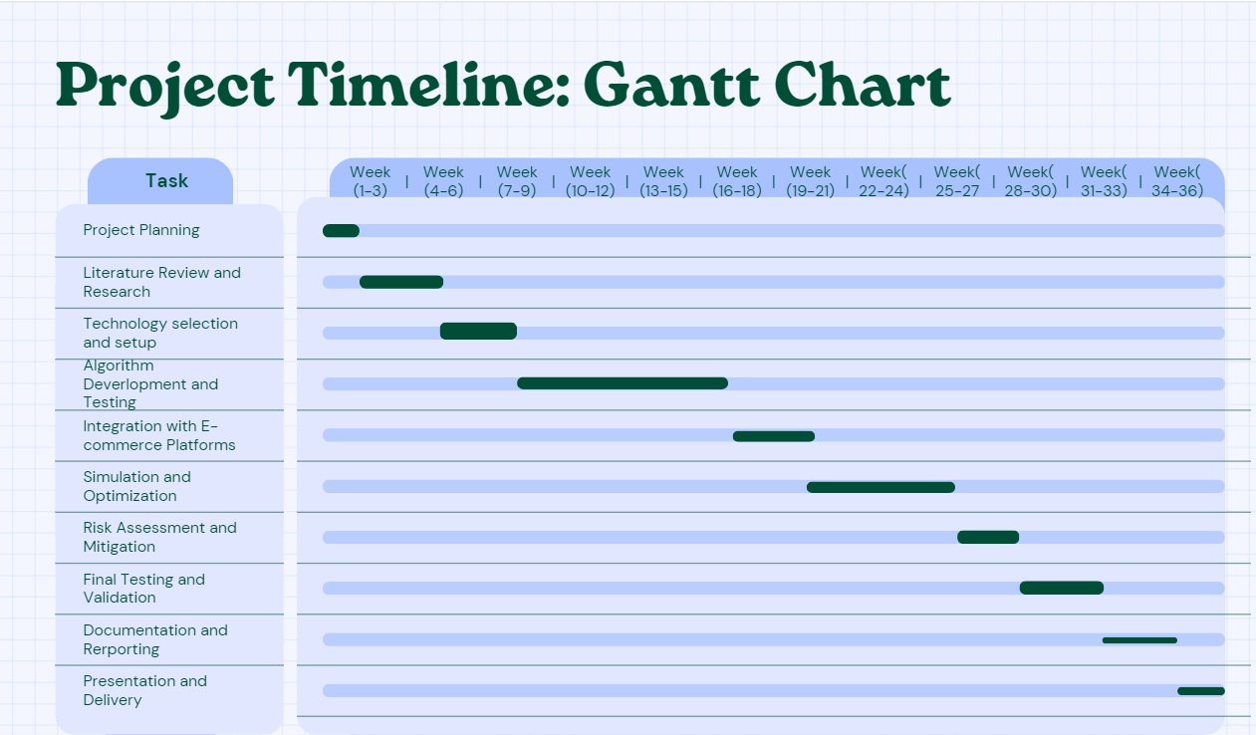
Project Timeline Use a Gantt chart to depict
Round 1

Slide 11
Estimated Project Budget Please show a high level budget with justification
Cloud Service Costs:
- It will depend on which cloud service is taking from IBM Quantum , Rigetti Computing or Amazon Bracket. The costs can come from Access and subscription Fee, Support Costs.
Personnel Costs:
- This costs include Software developers , Project Management
Training and Skill Development:
- Some in-house quantum expertise might be needed to enhance the team’s understanding and collaboration with the cloud service.
Documentation and Reporting: This includes Technical Writers.
Miscellaneous: This includes Contingency Fund, Software Licenses, Data security management , Scalability cost.
Round 1

Slide 12
Thank you!

